Slide 1
Platinum Data Project Wang Biyuan
2016.08.16 Presentation

Slide 2
Project Progress
Step I: Import data into MATLAB 【Implementing】
Step II: Data interpolation 【Implementing】
Step III: Data average 【Implementing】

Slide 3
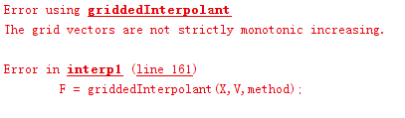
Project Progress
Recap: Step II Data Interpolation
Solution- function: unique or diff

Slide 4
Project Progress
Recap: Step II: Data Interpolation
Self-written function: avgdata=intpdd(FSZ,curve,structure)
Self-written function: avg=intpro(FSZ,curve,depth,structure)

Slide 5
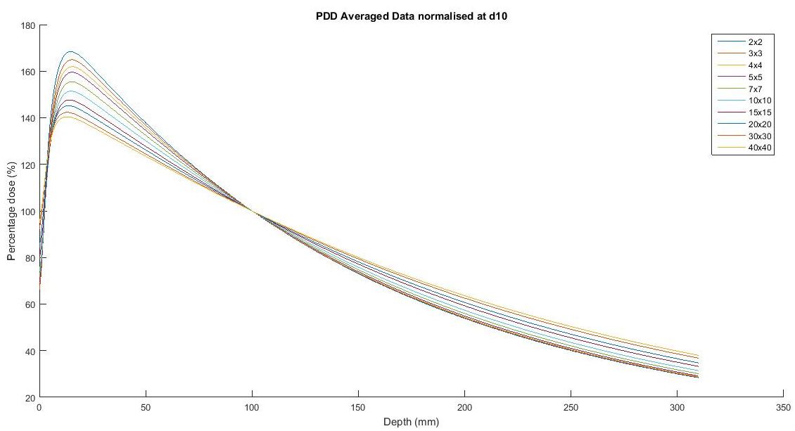
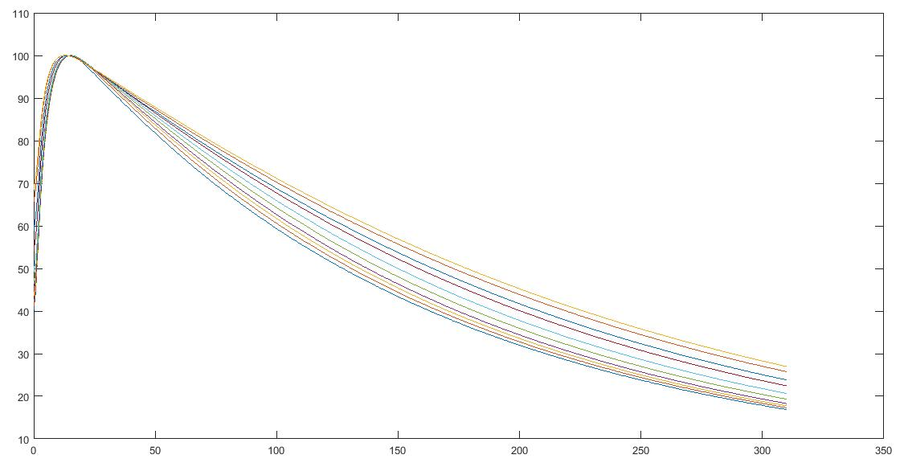
Project Progress
Recap: Step II: Data Interpolation

Slide 6

Project Progress
Scan Range Selection - Profile
SSD=90cm
SSD=100cm
Skin
depth
Scan range
FSZ

Slide 7
Project Progress
Scan Range Selection - PDD
The shortest scan range (depth) in the set of data
No less than 30cm

Slide 8
Future Work Plan
Finish data of other energy levels and machine types
Put the averaged data back to .asc files

Slide 9
THE END Thank you for your patience!

